Slide 1
ICP-MS Data Analysis using R Studio and Microsoft Excel
Created by Tomas Richardson-Sanchez (Murphy lab, Department of Microbiology & Immunology, University of British Columbia)
Last updated March 30, 2021

Slide 2
ICP-MS Data Analysis (R)
R analysis requires two .csv files: Data output from ICP-MS (‘Sample_run’) and sample preparation (‘Sample_digest’).
Made a new R-compatible Sample_digest template which can calculate digestion and dilution factors for us. We can decide on whether to keep the usual sample submission forms (usually done on paper then scanned to .pdf).
Guidelines for running R script: -Sample names MUST be consistent between these two files. -Must rename columns – add Sample_name, Sequence_position, use underscore between element and mass and remove the (cps) (e.g. Fe_56, not Fe 56 (cps)), remove ‘data file’, ‘acquisition time’ and ‘method file’ columns. -Must name standards ‘1 ppb standard’ for drift and ‘X ppb metal standard’ for standard curve. -Save files as .csv, not excel -Use latest version of Rstudio. Installation and loading of relevant R packages is included in the script. -Once script is open edit the file names in the script according to how you have named your files
R scripts: ‘ICPMS data analysis script (iron only)’ – Basic script for analysing iron only ‘ICPMS data analysis script (all metals)’ – Script for any combination of metals (includes drift adjustment) ‘ICPMS data analysis script (all metals no driftadjust)’ – Script for any combination of metals (no drift adjustment) *Martin Queinnec (PhD candidate, UBC Forestry department) adapted the ‘iron only’ script by writing extra data sorting and ‘for loops’ to allow analysis of all metals.
Drift adjustment – Unsure if this step should be included. There does not always appear to be drift, and adjusting the data based on a trendline of ‘1 ppb metal’ samples may be skewing the data in some cases. *Considering including conditional in R script: ‘apply drift adjustment if |m| > x and R² > y’

Slide 3
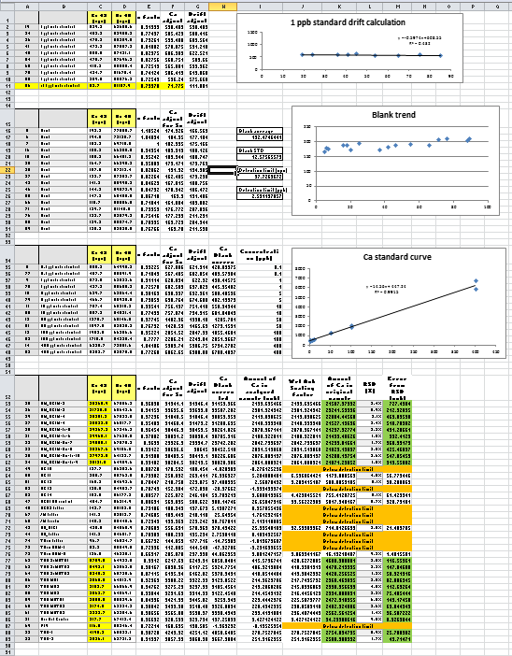
ICP-MS Data Analysis (Microsoft Excel)
Check for signal carryover or outliers.
Separate raw data for each metal into a separate tab.
Sort rows into 1 ppb standards, blanks, standard curves, and analytical samples.
Adjust all signals for the amount of Sc (internal standard) detected.
Calculate drift using 1 ppb metal standards and adjust all other signals accordingly.
Calculate the average blank value and use this to blank correct all other signals.
Graph standard curve after converting metal standard sample (e.g. 0.1 ppb metal standard) names to numeric values (e.g. 0.1)
Plot trendline of standard curve and use gradient as divisor to convert metal concentration to ppb.
Adjust metal concentration for scandium dilution during Wet Ash digestion and then by the sample dilution during digestion to get the metal concentration in the original sample.
Use raw RSD value (%) of each sample to calculate error in ppb.
Calculate standard deviation of blanks and multiply by 3 to get detection limit in cps, then convert to ppb using gradient of standard curve trendline.
Repeat steps 2-11 for each metal.

Slide 4
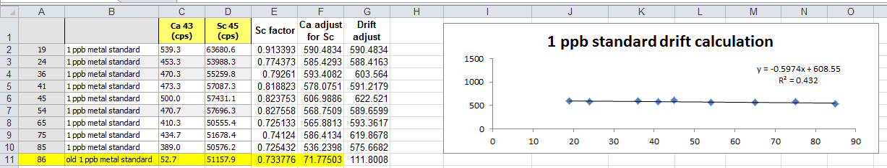
Data Analysis Steps 4-5
Adjust all signals for the amount of Sc (internal standard) detected. Sc factor is calculated for each sample by dividing the raw Sc cps value by a fixed value (usually the first Sc factor value). All Ca 45 cps values are then multiplied by their Sc factor to give Ca adjust for Sc. Do this for all samples in tab.
Calculate drift using 1 ppb metal standards and adjust all other signals accordingly. For 1 ppb metal standards, plot Ca adjust for Sc (y-axis) against sequence position (integer value in left column, x-axis) and add trendline with equation (y = mx + b) to see the signal drift throughout the run. Apply a drift adjustment to all Ca adjust for Sc samples in tab with the formula (Ca adjust for Sc) – m(sequence position – value of sequence position for first 1 ppb metal standard). For example, the first 1 ppb metal standard has sequence position 19 and the trendline has gradient m=-0.5947. Calculate the Drift Adjust for the second 1 ppb metal standard (sequence position 24, Ca adjust for Sc 585.4293) as 585.4293 – (-0.5947)(24 – 19) = 585.4293 + 0.5947(5) = 588.4163

Slide 5
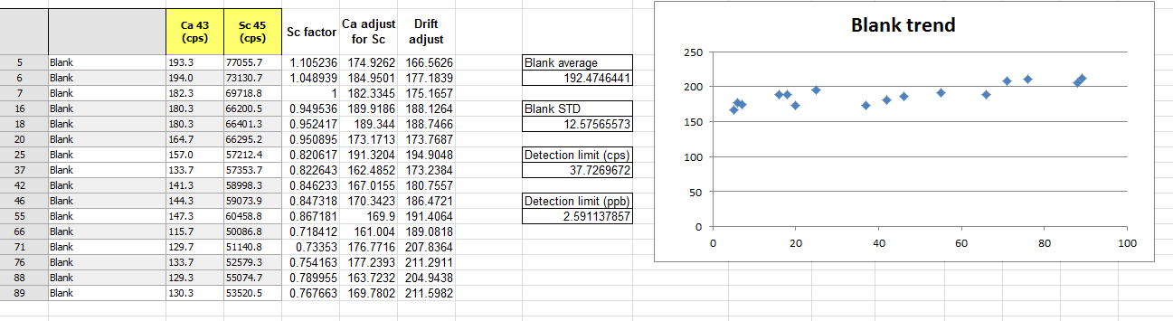
Data Analysis Step 6
Calculate the average blank value and use this to blank correct all other signals. Plot Blank Drift Adjust vs Sequence position to check visually for outliers. High values following concentrated samples result from signal carryover and must be removed. Take the average (Blank average) and standard deviation (Blank STD) of Drift Adjust values from all blanks. Substract the Blank average from all analytical sample Drift adjust values to give Ca Blank corrected. The Detection limit (cps) = Blank STD x 3, and can be converted to ppb later (step 8).

Slide 6
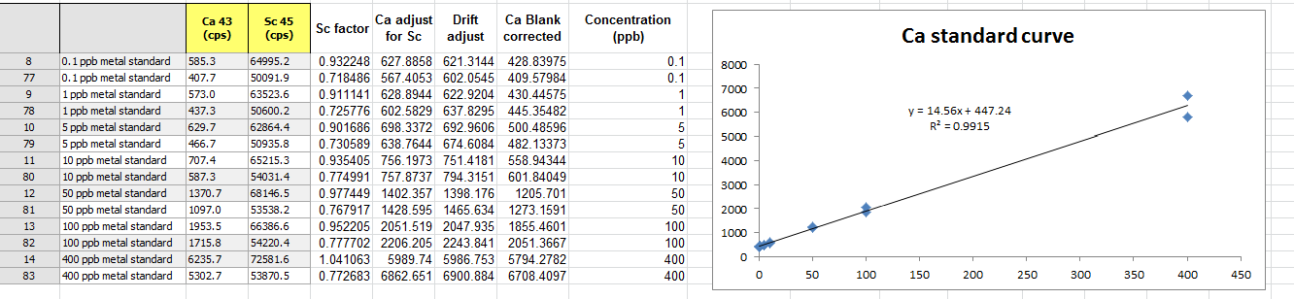
Data Analysis Steps 7-8
Graph standard curve after converting metal standard sample (e.g. 0.1 ppb metal standard) names to numeric values (e.g. 0.1). Assign numerical values (Concentration (ppb)) to standard curve samples so that they can be recognised as numbers for graphing.
Plot trendline of standard curve and use gradient as divisor to convert metal concentration to ppb. Plot Ca Blank corrected against Concentration (ppb) for all standard curve samples and add a trendline with equation (y = mx + b). Use the trendline gradient to calculate Amount of Ca in analyzed sample (ppb) as (Ca blank corrected)/m.

Slide 7
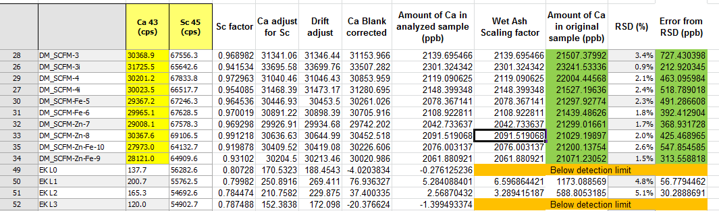
Data Analysis Steps 9-10
Adjust metal concentration for scandium dilution during Wet Ash digestion and then by the sample dilution during digestion to get the metal concentration in the original sample. Account for differences in Sc spike during sample prep by dividing Amount of Ca in analyzed sample by Wet Ash scaling factor. If dry ash was used then use scaling factor of 1 (no change), as entire sample was retained during digestion. Divide the result by the Sample dilution factor to get Amount of Ca in original sample.
Use raw RSD value (%) of each sample to calculate error in ppb. Calculate Error (ppb) for each analytical sample using Error = Amount in original sample x (RSD%)/100.

Slide 8
Resources
List of polyatomic interferences: https://www.perkinelmer.com/CMSResources/Images/44-74379ATL_TableOfPolyatomicInterferences.pdf
‘30 minute guide to ICP-MS’ by PerkinElmer: https://www.perkinelmer.com/CMSResources/Images/44-74849tch_icpmsthirtyminuteguide.pdf
Inorganic Ventures guide for ICP-MS operations: https://www.inorganicventures.com/pub/media/wysiwyg/files/IOV_ICP_OperationsGuide.pdf
Video on theory of NexION 300D by PerkinElmer: https://www.youtube.com/watch?v=4PRS17oa3I4
Detailed explanation of NexION 300D ICP-MS by US EPA in the context of wastewater analysis: https://19january2017snapshot.epa.gov/sites/production/files/2015-06/documents/icpms_fgd_collision-reaction_cell_procedure_draft_03-11-2013.pdf
Sample ‘Methods’ paragraph for manuscript: Closed vessel sample digestion was performed in 35% HNO₃ at 110 °C on a hotplate. Solvent was removed by drying before samples were redissolved in 1% HNO₃ with ⁴⁵Sc (20 ppb) as an internal standard. ICP-MS was performed using a NexION 300D (Perkin Elmer) equipped with a SC-2 DX autosampler, DXi-FAST micro-peristaltic pump, a cyclonic spray chamber, a triple cone interface, a quadrupole ion deflector and Universal Cell Technology. Calibration was performed using IV-Stock-4 calibration standard (Inorganic Ventures). All elements were run in reaction mode (using Dynamic Reaction Cell technology) using ammonia as a reaction gas to remove potential polyatomic interferences. The detection limit for ⁵⁶Fe was determined as 0.356 ppb.
Acknowledgements
Ashley Davidson (Crowe lab) – ICP-MS training and data analysis protocol. Martien Queinnec (UBC Forestry) – Help with R script. Angelé Arrieta – Sample preparation and digestion.

